Slide 1
Resilience project

Slide 2
Week 1-2

Slide 3
LLM - based solutions analysis: TFIDF comparison of solutions

Slide 4
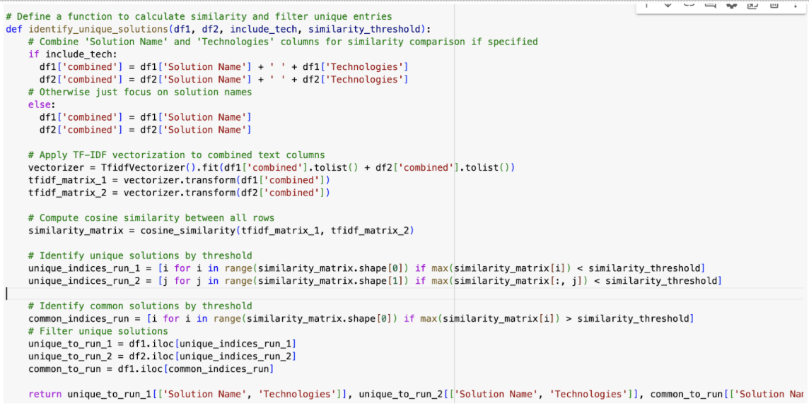
Identifying similar solutions based on TFIDF (Natural Language Processing) from the LLM based solution documents
Identifying similar solutions based on TFIDF (Natural Language Processing).
This script compares two sets of climate adaptation solutions (`solutions_run_1` and `solutions_run_2`) to identify unique and common solutions based on similarity in their names (and optionally, technologies).:

Slide 5
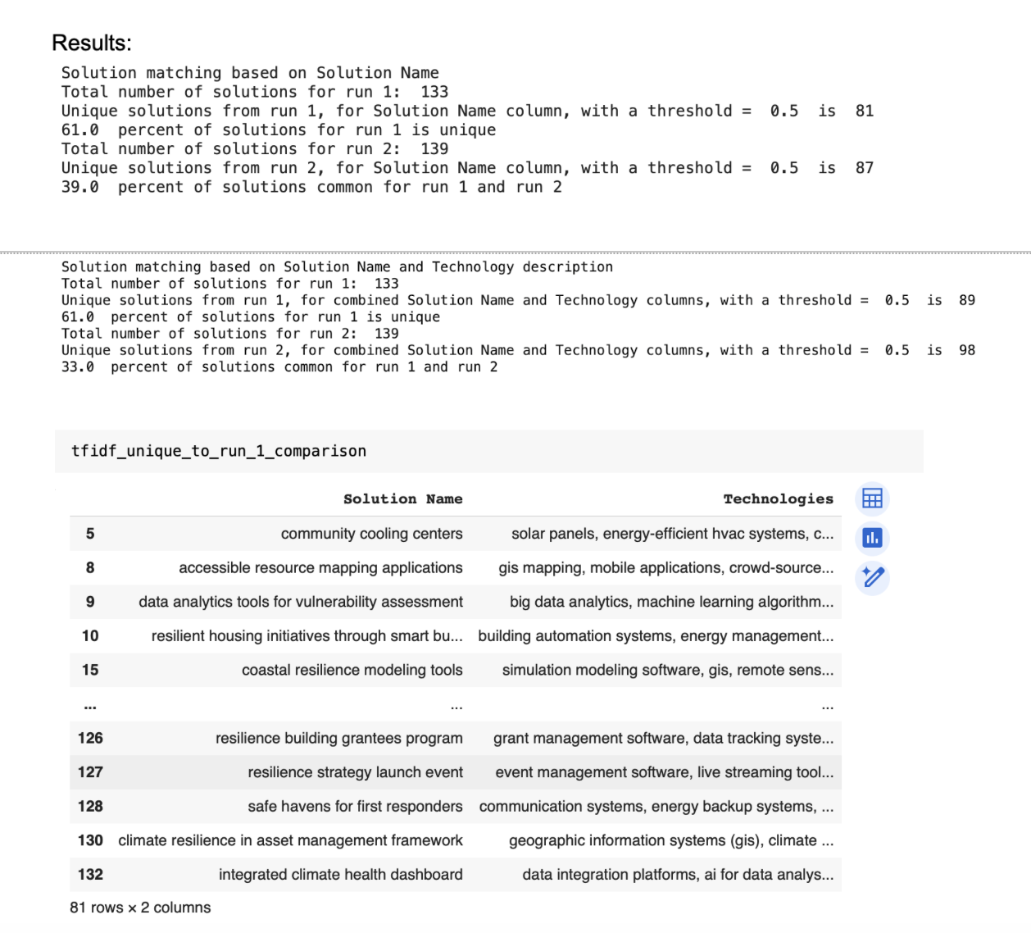
TFIDF (Natural Language Processing) from the LLM based solution documents
TF-IDF Purpose: TF-IDF assigns a higher weight to distinctive words (those frequent in one solution but rare across all). This representation, paired with cosine similarity, helps identify solutions that are similar but not identical, even if they use different wording.

Slide 6
TFIDF (Natural Language Processing) from the LLM based solution documents
Summary analysis:
1. Category Differences:
- Run 1: Solutions are often more specific to certain scenarios (e.g., "Snow and Ice Management Technologies," "Community Cooling Centers").
- Run 2: Some solutions encompass broader themes, combining multiple aspects (e.g., "Sustainable Urban Mobility Solutions," which addresses transportation as a whole).
2. Solution Name Variability:
- Some solutions appear in both runs with minor differences in naming. For instance:
- "Wildfire Risk Assessment Tools" in Run 1 versus "Fire Weather Monitoring System" in Run 2.
- This naming variability suggests slight inconsistencies in how similar solutions are labeled, potentially due to different keywords or terminologies.
3. Technologies Field:
- Both runs include similar technologies, such as "machine learning," "remote sensing," and "satellite imagery."
- Run 2 tends to list a broader range of technologies for some solutions (e.g., "Data analytics, satellite imagery" vs. Run 1 listing "Data analytics" alone). This indicates that Run 2 may capture more comprehensive technology descriptions.
4. Description Differences:
- Descriptions between runs are generally similar but may vary in wording. For example:
- Run 1 might describe, "Using IoT sensors for monitoring," while Run 2 uses, "Deploying IoT and real-time sensors."
- Although these differences don’t change the meaning significantly, they introduce variability that could affect how solutions are matched.
5. Unique Solutions:
- Each run has unique solutions not found in the other, such as:
- Run 1: "Emergency Communication Networks" and "Community Cooling Centers."
- Run 2: "Sustainable Urban Mobility Solutions" and "Landslide Monitoring System."
- These unique solutions highlight the tool’s capability to detect different solution nuances in each run, possibly based on varied extraction methods or data sources.
Summary: Although there is overlap between the two runs, differences in naming, categorization, and phrasing lead to some inconsistencies in identifying climate adaptation solutions. Harmonizing terminology and categorization could help in reducing discrepancies, creating a more uniform dataset across multiple extraction runs.

Slide 7
LLM - based solutions analysis:
verification with Toronto plan

Slide 8
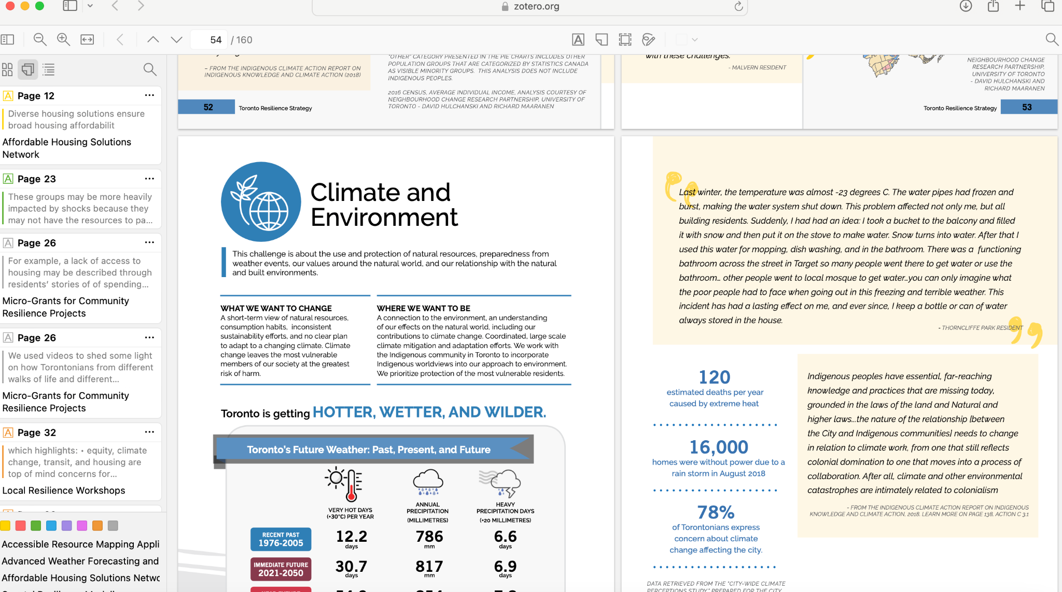
Verification of solutions in the Toronto plan (annotation with Zotero)

Slide 9
Verification with Toronto plan
1. Best-Matched Solutions:
- Solutions with the highest alignment to the Toronto Resilience Strategy were rated 3/3. These include:
- "Resilient Coastal Infrastructure" (Page 95): A highly aligned solution focusing on coastal protection through infrastructure and real-time monitoring.
- "Community Engagement Platforms" (Pages 84, 129): Includes multiple initiatives for enhancing community-driven resilience engagement.
- "Wildfire Risk Assessment Tools" (Page 149): Utilizes data analytics and satellite imagery for proactive wildfire risk management.
2. Partial Matches:
- Some solutions received a 2/3 rating, indicating partial alignment with strategy content. For example:
- "Snow and Ice Management Technologies" (Page 98): Mentioned in general maintenance and winter resilience sections but lacks specific technology details.
- "Resilient Housing Initiatives through Smart Building Technology" (Pages 120, 140): Discussed under resilient housing upgrades, though specific smart technology is not emphasized.
3. Not Mentioned Solutions:
- Approximately 39.4% of solutions were either partially or entirely missing from the strategy document. Examples include:
- "Wildfire Risk Mitigation Technology" and "Infectious Disease Surveillance Systems" – both solutions address critical areas but were not directly referenced in the strategy.
4. Summary:
- The dataset illustrates a broad overlap with the strategy, though some high-priority technologies, especially related to specific climate threats like infectious disease monitoring, were not explicitly covered. Solutions that align closely with the strategy (rated 3/3) reflect the strategy’s focus on community resilience, coastal infrastructure, and emergency response.

Slide 10
Week 3-4

Slide 11
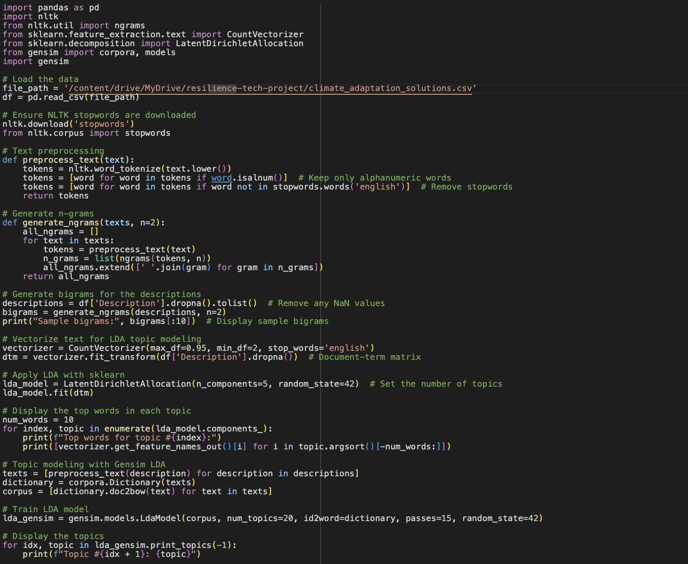
Script that creates ngrams and generates topics using LDA

Slide 12
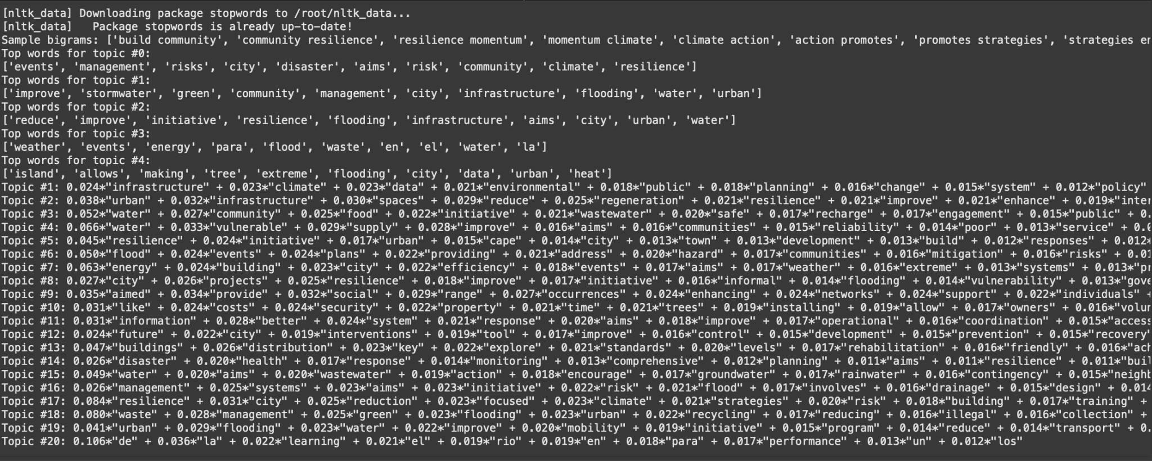
Output of the script

Slide 13
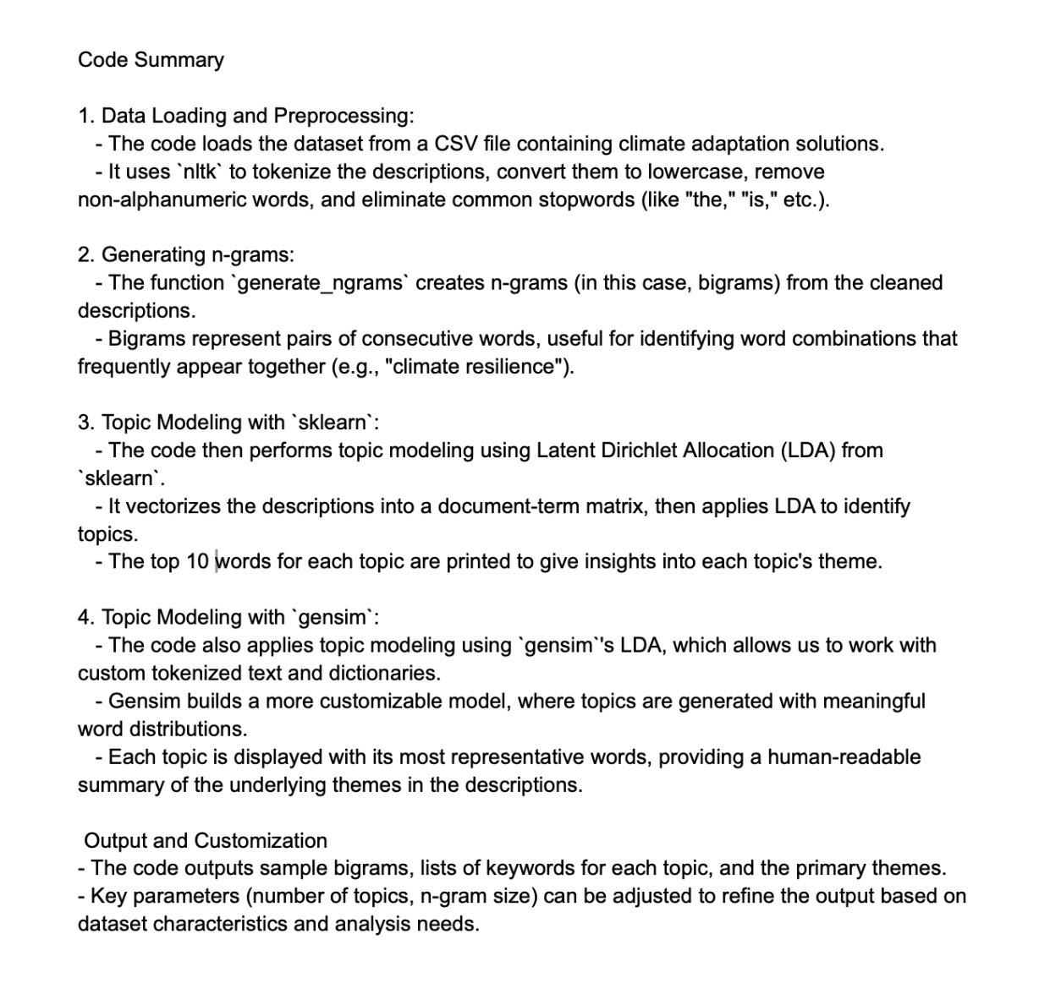

Slide 14
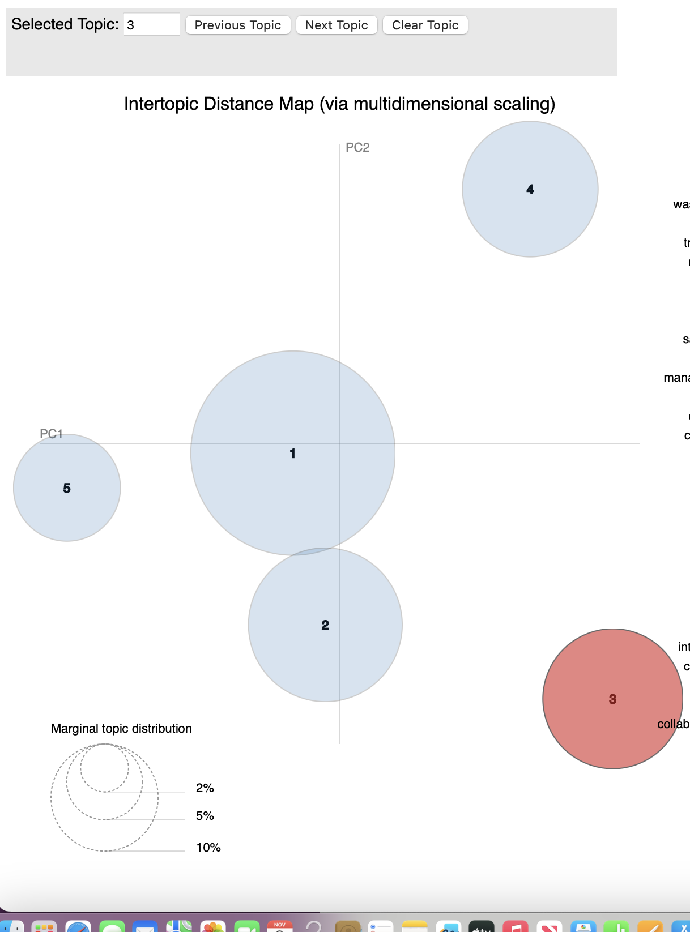
Web app explanation
1. Intertopic Distance Map (Left Panel)
Purpose: This map provides a visual representation of the topics and their relationships to each other, using Multidimensional Scaling (MDS) to plot them in 2D space.
Circles: Each circle represents a topic. The size of the circle indicates the prevalence or relative frequency of the topic in the corpus.
Distances:
The distance between circles shows how closely related the topics are. Closer circles indicate that topics share more words in common, while distant circles are more distinct.
Selected Topic: In this screenshot, Topic 3 is selected and highlighted in red. This selection affects the terms displayed in the right panel.

Slide 15
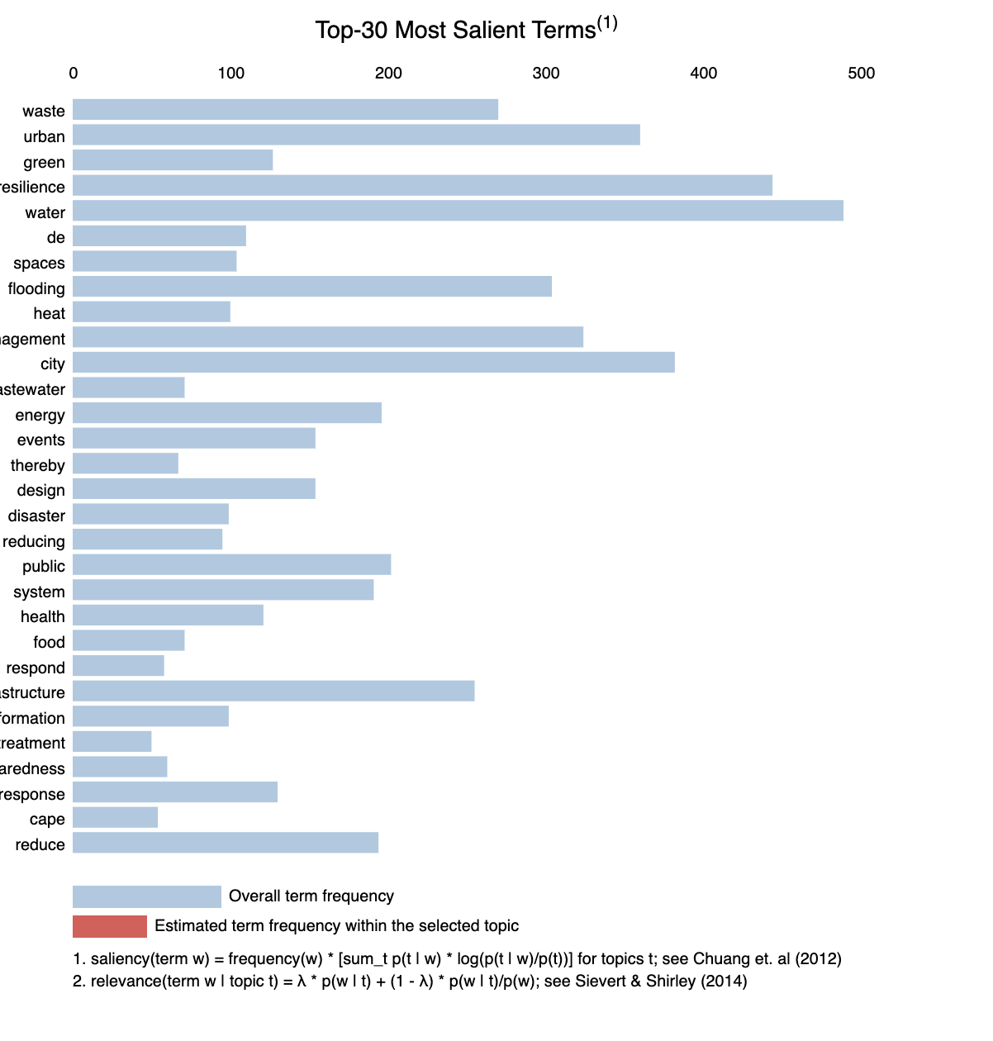
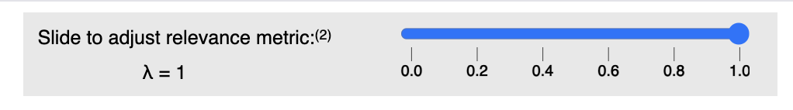
Web app explanation
2. Top-30 Most Relevant Terms for Selected Topic (Right Panel)
Purpose: This bar chart shows the top terms most relevant to the currently selected topic, in this case, Topic 3.
Bars:
Red bars represent the frequency of each term within the selected topic.
Blue bars represent the overall frequency of each term across the entire corpus.
The length of the red bar relative to the blue bar indicates how much the term is specific to this topic compared to the whole corpus.
Terms: The terms help interpret the topic's content. For example, terms like "waste," "management," "system," "sanitation," and "water" suggest that Topic 3 might relate to waste management and sanitation.
3. Lambda (λ) Slider (Top Right)
Purpose: The λ slider controls the relevance metric for displaying terms in the selected topic.
Relevance Metric (λ):
λ is a parameter that adjusts the balance between term frequency (how often a term appears) and exclusivity(how unique a term is to the topic).
A λ value of 1 shows terms that are highly frequent within the topic (possibly shared with other topics).
A λ value of 0 shows terms that are highly exclusive to the topic (even if infrequent).
In the example (λ = 0.6), the relevance metric favors terms that are relatively frequent in the topic but still somewhat exclusive.

Slide 16
Web app explanation
4. Marginal Topic Distribution (Bottom Left)
Purpose: This small inset visualizes the overall distribution of topics in the corpus, with circle sizes corresponding to topic prevalence.
Interpretation: It helps quickly understand which topics are most common in the corpus. Larger circles indicate topics that occupy a higher percentage of the overall text.
Key Terms in the Explanation (Bottom Right)
Saliency: Indicates the importance of a term in the overall corpus, balancing frequency and relevance.
Relevance: Calculated as the relevance of a term within a topic, based on λ and the term’s exclusivity and frequency.
Summary Interpretation of This Visualization
In this visualization:
Topic 3 (highlighted in red) appears as a distinct, moderately prevalent topic.
Based on the right panel's terms, Topic 3 is likely about waste management, sanitation, and related infrastructure.
Adjusting λ lets you explore terms that are more frequent or exclusive, helping you gain nuanced insights into what defines each topic.

